Slide 1

Cyclistic Bike-Share Customer Analysis
Presented By Benjamin Allen
Last Updated: 7/31/2022

Slide 2
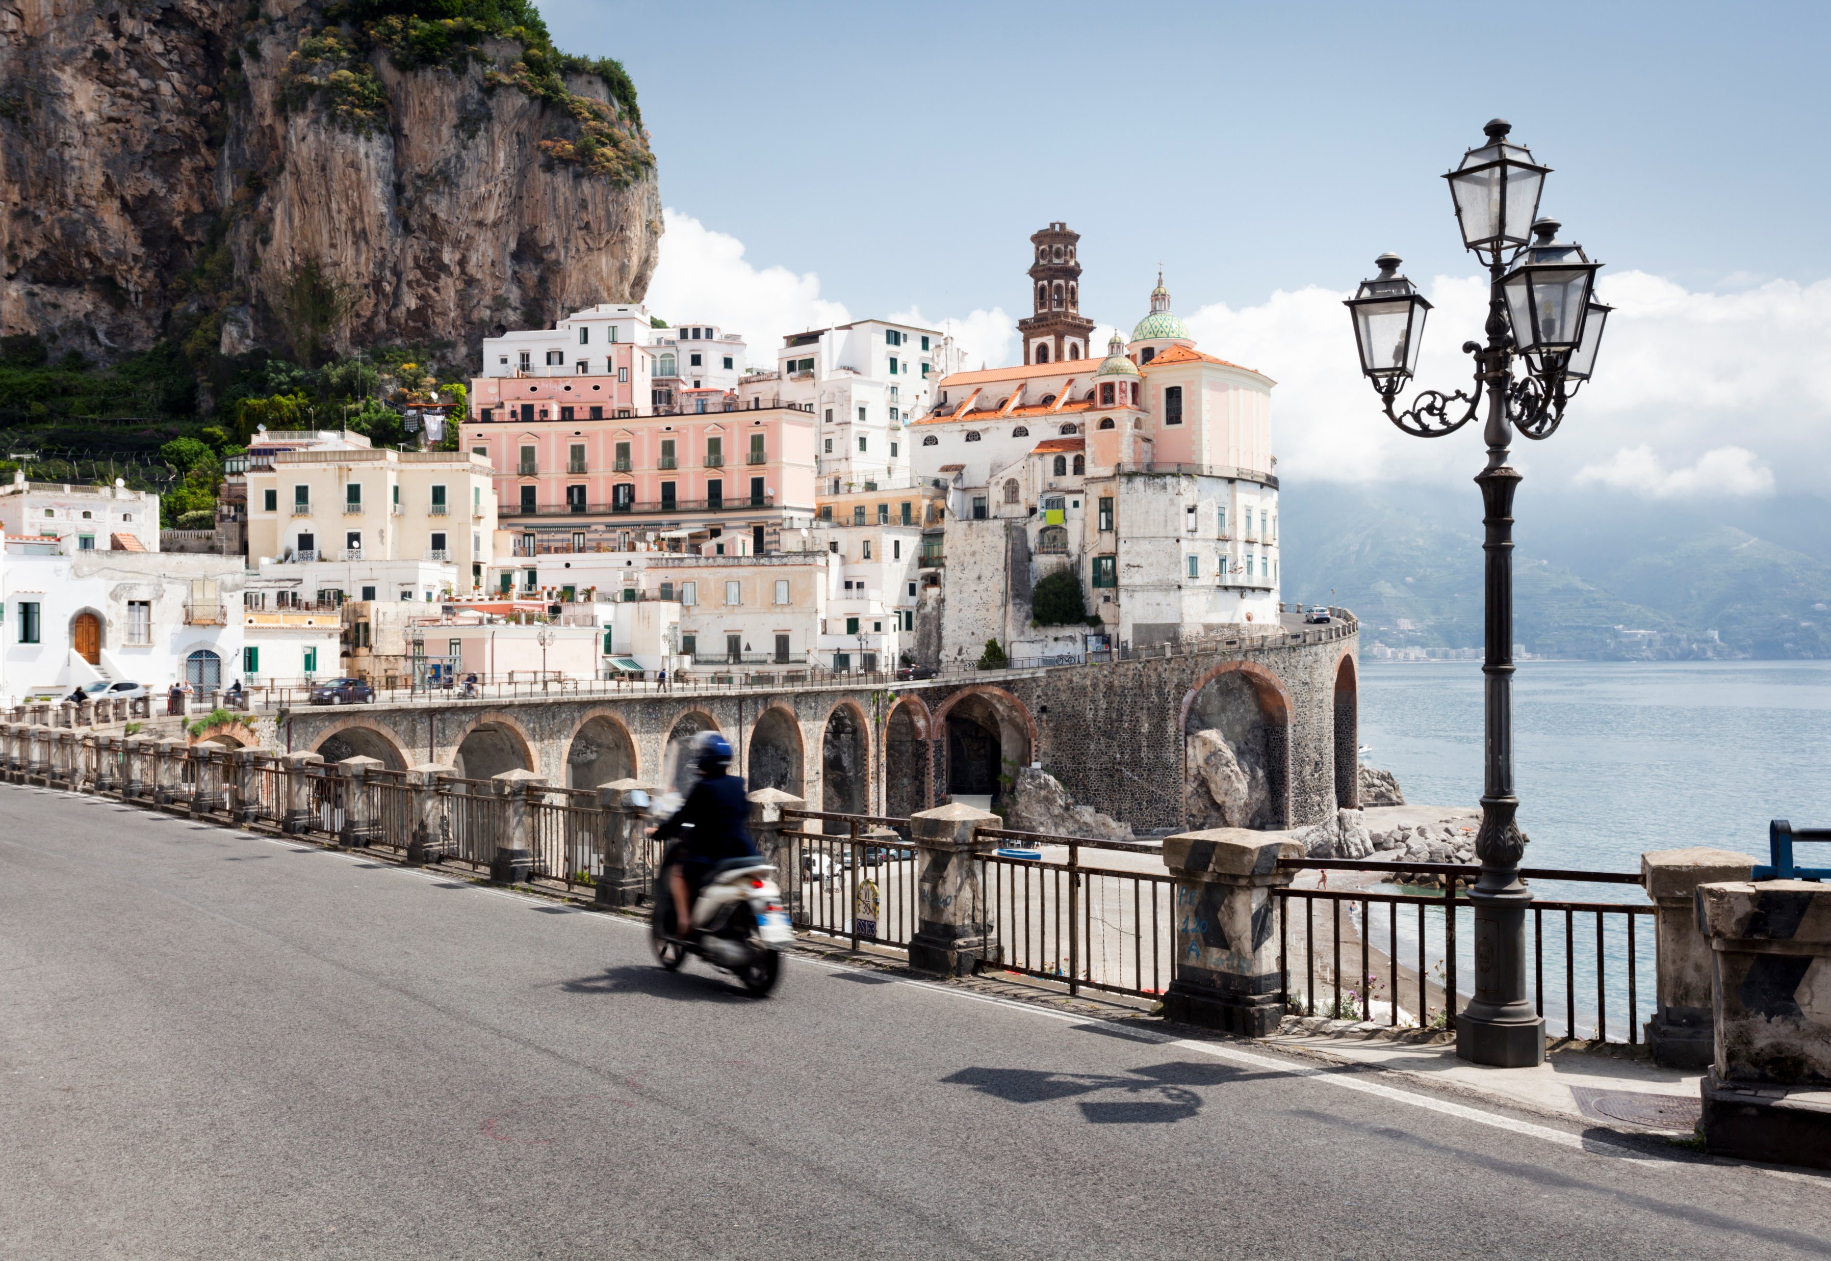
Agenda
The agenda for today:
Introductions
Project overview and goals
Data and analysis
Conclusions
Actionable steps
Questions

Slide 3
Project Overview
Cyclistic has two types of customers, casual and members
Members have proven to be more profitable than casual riders
Future marketing is to be aimed at converting casual riders to annual memberships
The goal for this analysis:
Identify actionable differences between casual customers and members

Slide 4
Project Data
The following datasets were used for analysis:
The past 12 months (July 2021 – June 2022) of Cyclistic trip data Retrieved from: https://divvy-tripdata.s3.amazonaws.com/index.html
Official geographic data on Chicago neighborhoods
Retrieved from: https://data.cityofchicago.org/Facilities-Geographic-Boundaries/Boundaries-Neighborhoods/bbvz-uum9

Slide 5
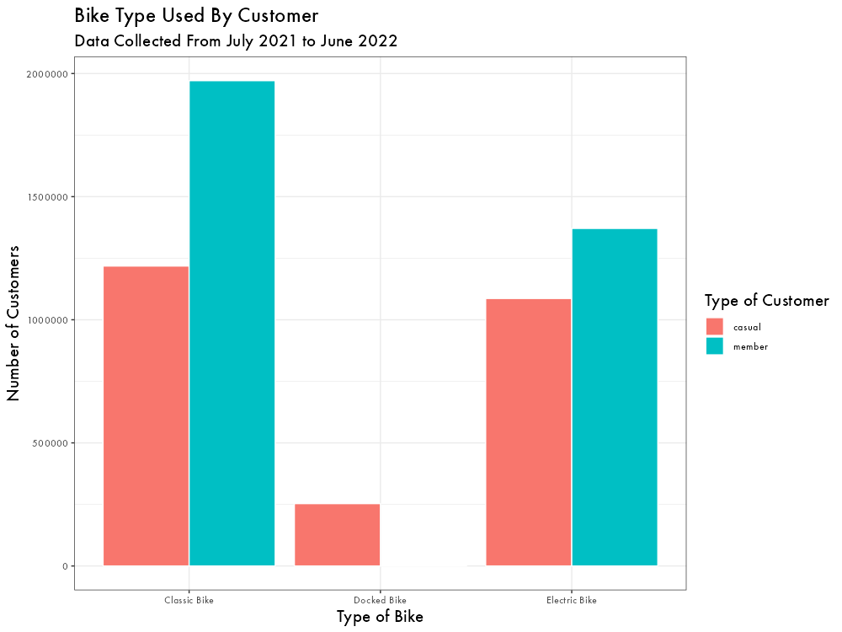
Differences in Bike Type
First, a breakdown of bike type and customer
Casual riders use classic and electric bikes roughly equally
Casual riders are also the only users of docked bikes
Members tend to ride classic bikes significantly more than electric bikes

Slide 6
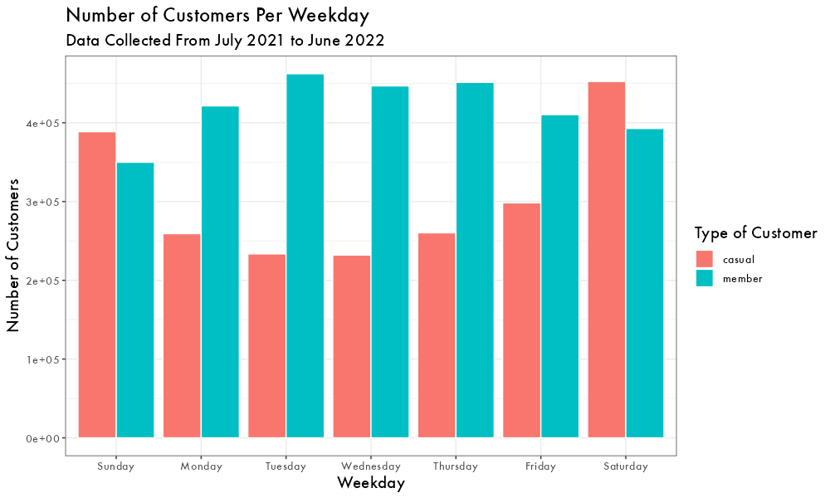
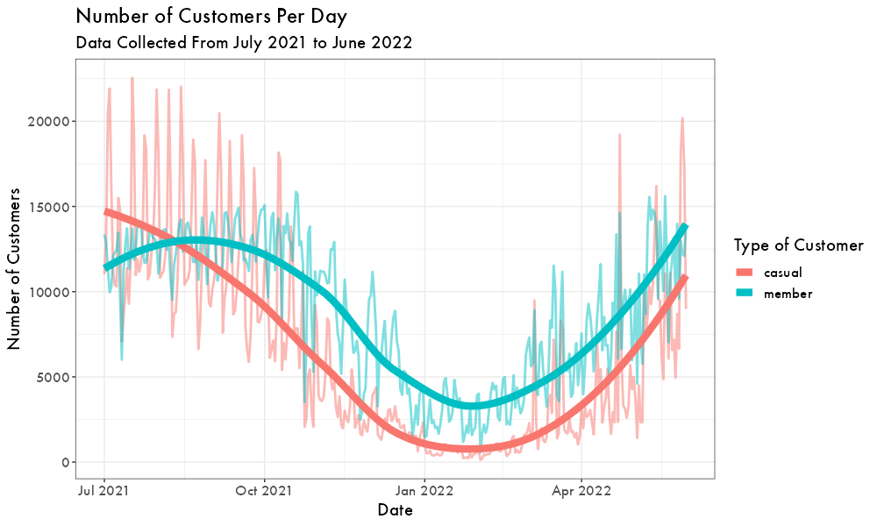
Differences in Daily Usage
Next, looking at changes in usage due to time
Casual riders use bike-share most often on the weekend; members usage is distributed throughout the week
Casual usage peaks in July, while member usage peaks later in September
Both groups’ usage is minimal in February, however member’s usage is more stable throughout the year

Slide 7
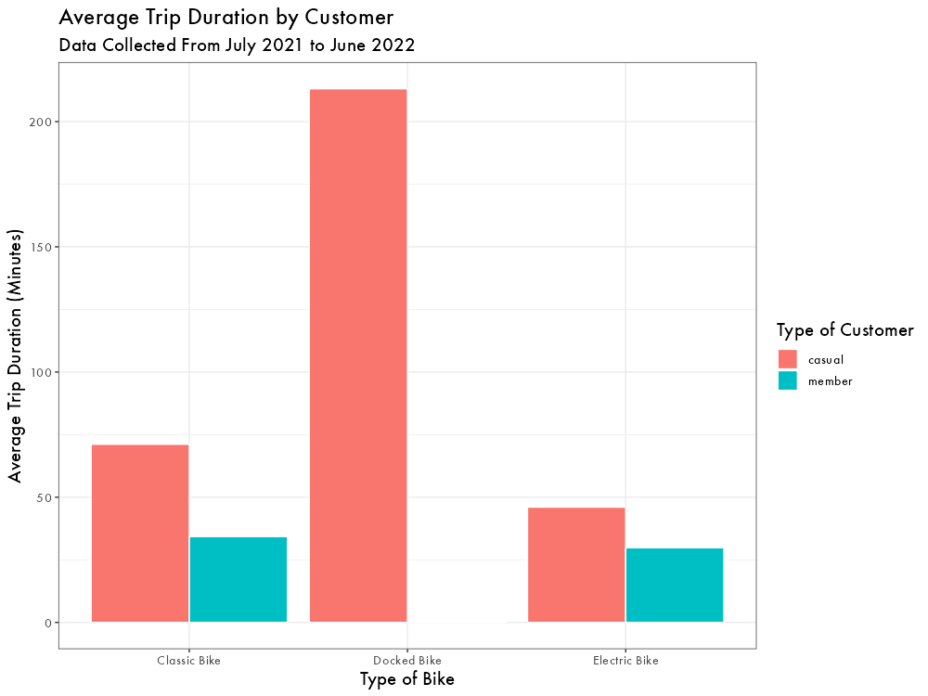
Trip Duration
Members tend to ride for shorter durations
Both types of riders use classic bikes longer than electric bikes
Docked bikes are used by casual riders for significantly longer trips

Slide 8
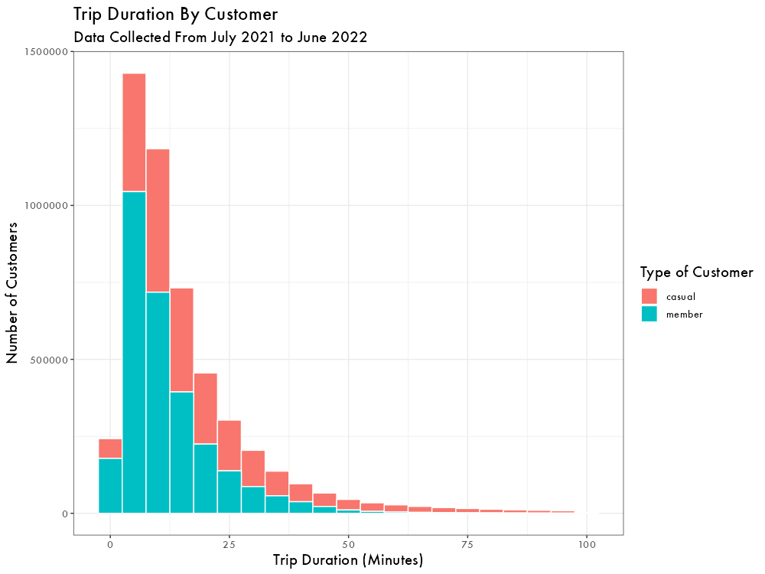
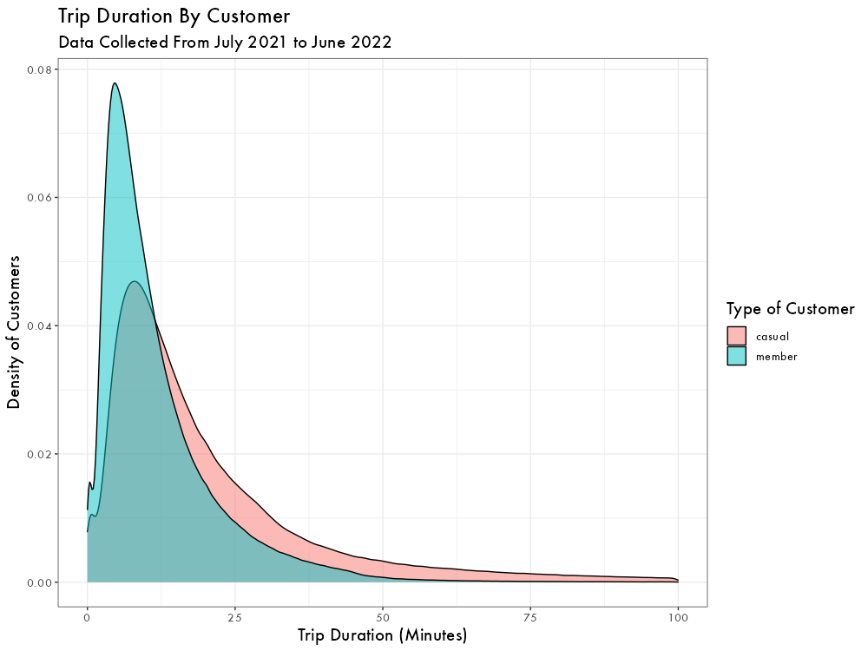
Trip Duration
Members’ median trip duration is ~9 minutes
For casual riders this is ~15 minutes
The distribution for casual riders is more heavily right skewed, indicating more long duration rides

Slide 9
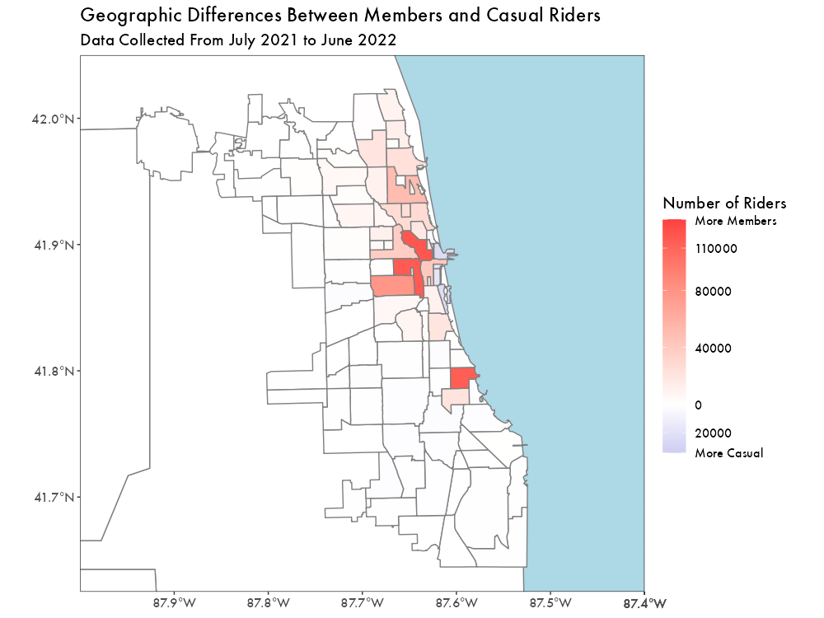
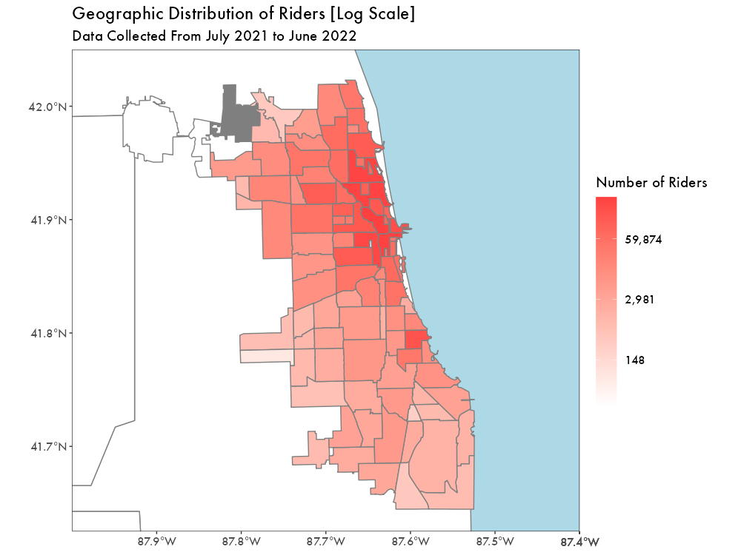
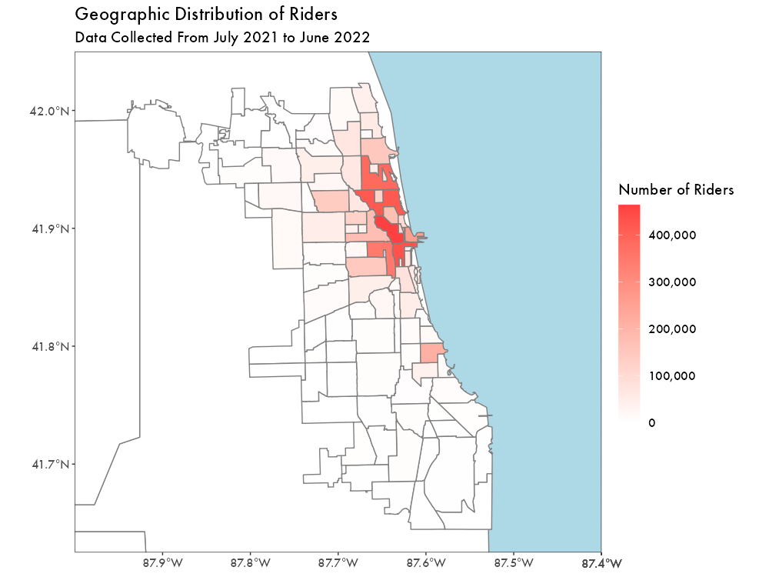
Looking at Geography
Looking at the geographic distribution of all riders, it is primarily centered in downtown Chicago
Using a logarithmic scale, the gradual decrease in ridership as one moves away from downtown in more obvious
Multiple areas within downtown that are member-heavy
Central areas along the coast show slightly more casual bias

Slide 10
Conclusions
Casual riders tend to use bikes recreationally
Higher weekend usage
More summer usage/less winter usage
Longer trip duration
Members use bike-share for practical commuting
Higher usage during the work week
More consistent usage throughout the year
Members are centralized in the downtown area

Slide 11

Actionable steps
Identify how memberships can be beneficial for recreational users
Enhance membership value for less frequent riders
Increase advertising in areas with a heavier casual presence

Slide 12
Questions?

Slide 13
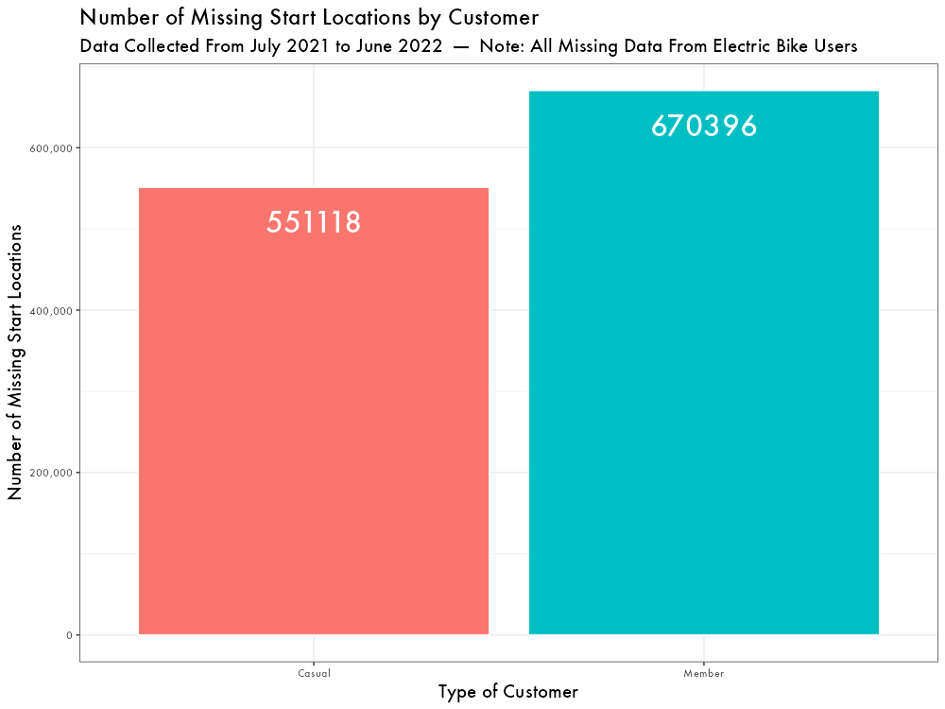
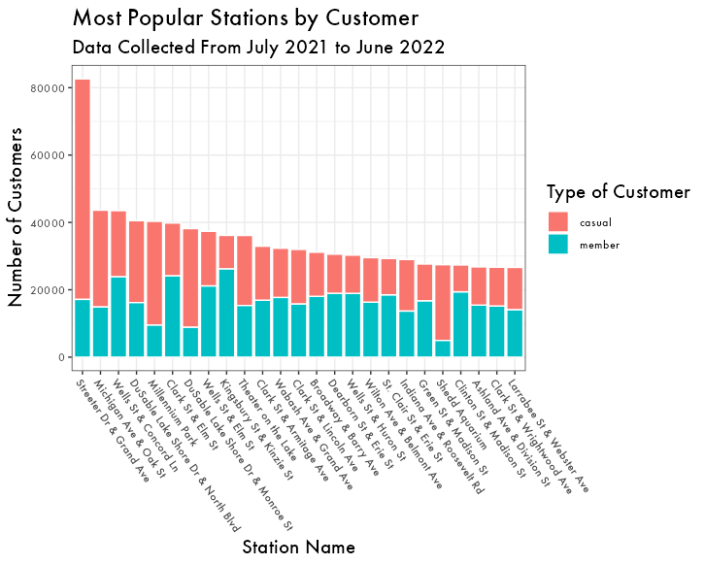
Appendix

